Slide 1
CPU Organization Course day 2
Alexander Titov
24 December 2014

Slide 2
Course Roadmap
Day 1
Pipeline
Memory Hierarchy (Caches)
Day 2
Out-of-order execution
Branch prediction
Day 3
Real example: Haswell Microarchitecture

Slide 3
Refresher: Pipeline
Pipeline improves throughput of CPU by overlapping instruction processing
Max speed is one instruction per clock (IPC = 1; CPI = 1/IPC)
The real speed is less due to dependencies among instructions (both data and control) and in-order execution
F | D | E | M | W
 | F | D | E | M | W
 |  | F | D | E | M | W
M | W
 |  |  | F | D | E | M | W
 |  |  |  | F | D | E | M | W
 |  |  |  |  | F | D | E | M | W
F | Stall
D | E | M | W
F | D | E | M | W
 | F | D | E | M | W

Slide 4
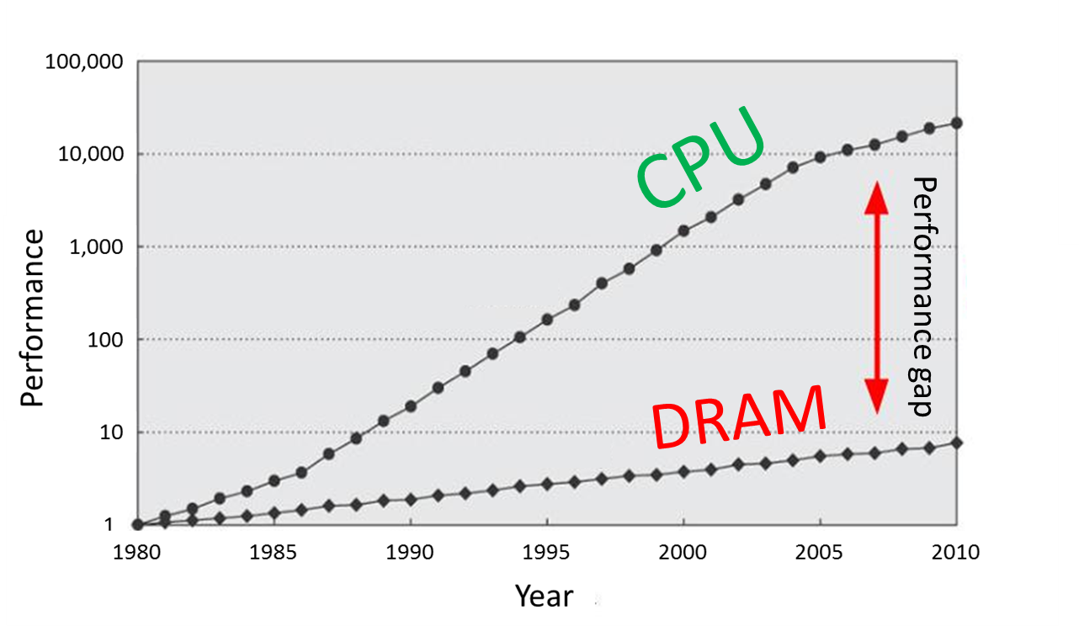
Refresher: Memory Hierarchy
Main memory is large, but too slow
Luckily, there are temporal and spatial locality in our workloads
Memory hierarchy provides visibility that memory is usually fast
L3
Cache
Main Memory
L1
L2
CPU
smallest, but fastest
slowest, but largest

Slide 5
Refresher: Caches
Three types of caches
Fully Associative: no conflict, but slow and complex HW
Direct MAP: fast and simple HW, but many conflicts
Multi-Way: something in between (more ways → closer to fully associative)
Example: 32KB, 8 ways, 64B line
Replacement – LRU
Prefetch – predict future accesses
The more levels → the shorter AMAT (but large HW)
address
64 | 11 |  | 5 | 0
Tag | Set |  | Offset
→
way size = 32KB / 8 = 4KB
# of sets = 4KB / 64B = 64

Slide 6
Superscalar: wide pipeline
Pipeline exploits instruction level parallelism (ILP)
Can we do it better?
Need to double HW structures
Max speedup is 2 instruction per cycle (IPC = 2)
The real speedup is less due to dependencies and in-order execution
– Yes, execute instructions in parallel
F | D | E | M | W
 | F | D | E | M | W
 |  | F | D | E | M | W
F | Stall
F | Stall
D | E | M | W
F | D | E | M | W
 | F | D | E | M | W

Slide 7
Is Superscalar Good Enough?
Theoretically can execute multiple instructions in parallel
Wide pipeline → more performance
But…
Only independent subsequent instructions can be executed in parallel
Whereas subsequent instructions are often dependent
So the utilization of the second pipe is often low
Solution: out-of-order execution
Execute instructions based on the “data flow” graph, (rather than program order)
Still need to keep the visibility of in-order execution

Slide 8
Data Flow Analysis
Example:
Data Flow Graph
(1) r1 ← r4 / r7
(2) r8 ← r1 + r2
(3) r5 ← r5 + 1
(4) r6 ← r6 – r3
(5) r4 ← load [r5 + r6]
(6) r7 ← r8 * r4
1
3
4
r1
r5
r6
2
5
r8
r4
6
In-order execution
Out-of-order execution
1
2
1
2
3
5
6
3
5
6
4
4

Slide 9
Parallel algorithms
Sequential code (ISA)
Sequential hardware
Initially, HW was very simple: sequential execution, one instruction at a time
The sequential code representation was natural and convenient

Slide 10
Parallel algorithms
Sophisticated
parallel
hardware
Sequential code (ISA)
Sequential hardware
Visibility of
sequential HW
Then, technology allowed building wide HW, but the code representation has stayed sequential
Decision: extract parallelism back by means of HW
Due to compatibility still need look like sequential HW

Slide 11
Why Is Order Important?
Many mechanisms rely on original program order
Precise exceptions: nothing after instruction caused an exception can be executed
(1) r3 ← r1 + r2
(2) r5 ← r4 / r3
(3) r2 ← r7 + r6
Memory model: inter-thread communication requires that the memory accesses are ordered
What if they are executed in the following order: (1) → (3) → (2)
and then (2) leads to exception?
LD A ST B LD B ST A
Load A returns new data, Load B returns old data = NOT ALLOWED
LD A LD B ST B ST A
Both loads return new data = NOT ALLOWED

Slide 12
Maintaining Arch State
Solution: support two state, speculative and architectural
Update arch state in program order using special buffer called ROB (reorder buffer) or instruction window
Instructions written and stored in-order
Instruction leaves ROB (retired) and update arch state only if it is the oldest one and has been executed
Sequential code
Fetch & Decode
Instruction window
Retirement
Visibility of
sequential execution
Architectural state
Out-of-order execution
Speculative state
Legend:
Out-of-order
In-order

Slide 13
Dependency Check
HW instruction window (ROB)
15
14
13
12
11
10
9
8
7
6
5
4
3
2
1
0
Fetch
?
Retire
r3 ← r1 + r2
r1 ← …
r2 ← …
r1 ← …
Src1:
Src2:
ready
Consumers:
.., #15
not ready
Legend:
Ready, but not executed
For each source check its previous producer
Executes
Not ready
If both sources are ready then instruction is ready
If a source is not ready, write the instr# into the consumer list of producer
When an instruction becomes ready, send a signal to all consumers that their sources become ready too
For loads need also to check addresses of all previous stores

Slide 14
How Large Is Window Needed?
In short, the large window → the better
Find more independent instructions
Hide longer latencies (e.g., cache misses, long operations)
Example
The modern CPU has a window of 200
If we want execute 4 instruction per cycle, then we can hide latency of 50 cycles
It is enough to hide L1 and L2 misses, but not L3 miss
But, there are limitation to find independent instructions in a large window:
branches and false dependencies

Slide 15
Limitation: False Dependencies
Example:
Data Flow Graph
(1) r1 ← r4 / r7
(2) r8 ← r1 + r2
(3) r5 ← r5 + 1
(4) r6 ← r6 – r3
(5) r4 ← load [r5 + r6]
(6) r7 ← r8 * r4
1
3
4
r1
r1
r1
r5
r6
2
5
r1
r8
r4
6
Out-of-order execution
False Dependencies:
Write-After-Write: (1) → (3)
1
2
3
5
6
Write-After-Read: (2) → (3)
4
Significantly decrease performance

Slide 16
Register Renaming
Redo register allocation that was done by compiler
Eliminate all false dependencies
Example:
Renaming
(1) r1 ← r4 / r7
(2) r8 ← r1 + r2
(3) r1 ← r5 + 1
(4) r6 ← r6 – r3
(5) r4 ← load [ r1 + r6 ]
(6) r7 ← r8 * r4
pr10 ≡ r1
pr11 ≡ r8
pr12 ≡ r1
pr13 ≡ r6
pr14 ≡ r4
pr15 ≡ r7
pr10
pr11
pr10
pr12
pr13
pr14
pr12
pr13
pr15
pr11
pr14
Register Aliases Table (RAT)
 | r0 | r1 | r2 | r3 | r4 | r5 | r6 | r7 | r8
pr12
pr14
pr15
pr10
pr13
pr11

Slide 17
Limitation: Branches
How to fill a large window from a single sequential instruction stream in presence of branches?
Branch with unknown condition
…
Retire
Fetch
deleted
How harmful are branches?
In average, each 5th instruction is a branch
If follow one branch path randomly, then accuracy is 50%
The probability that 100th instruction in the window will not be removed is (50%)^20 = 0.0001%
Need significantly increase accuracy!
All subsequent instructions are fetch according to prediction
If prediction was wrong, all the subsequent instructions are deleted
Verify the branch prediction
Speculatively fetched instructions can be executed too

Slide 18
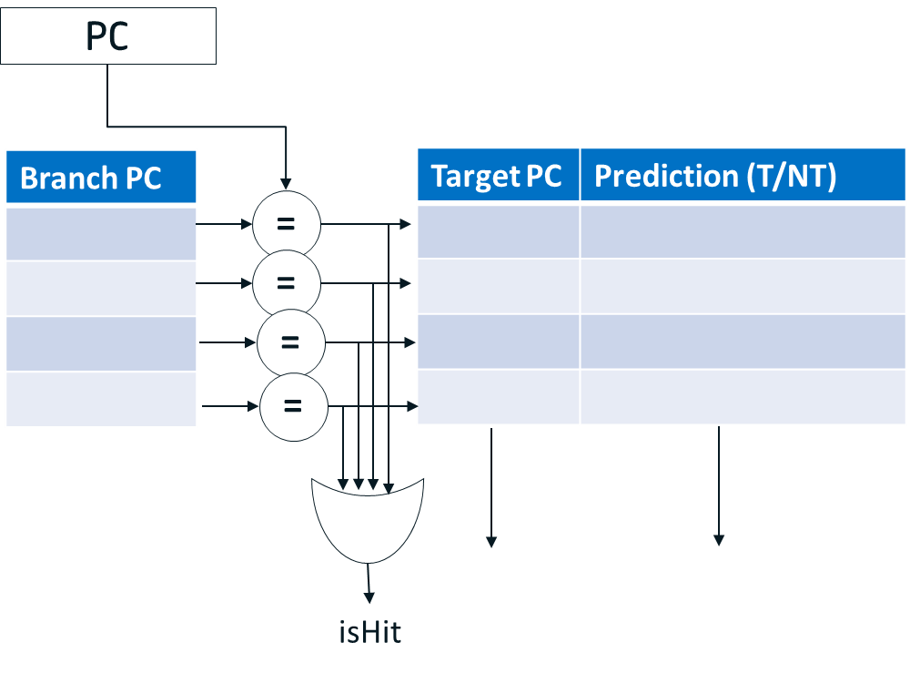
Dynamic Branch Prediction
Dynamic branch prediction approach:
As soon as branch is fetched (at IF stage) change the PC to the predicted path
Switch to the right path after the branch execution if the prediction was wrong
It required complex hardware at IF stage that will predicts:
Is it a branch
Branch taken or not
Taken branch target
Structure performs such function is called BPU

Slide 19
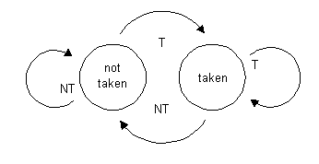
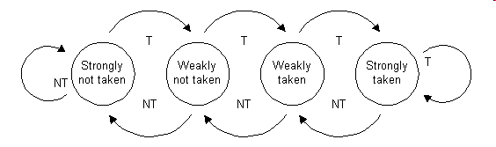
How To Predict Branch Outcome?
A saturating counter or bimodal predictor is a state machine with four states:
Why four states?
Bimodal predictor make only one mistake on a loop back branch (on the loop exit)
Advantages:
Small – only 2 bits per branch
Predicts well branches with stable behaviour
Disadvantages
Cannot predict well branches which often change their outcome:
e.g. T, NT, T, NT, T, NT, T, NT, T, …

Slide 20
Using History Patterns
Remember not just most often outcome, but most often outcome after certain history patterns
present
future
past
Pattern history table
00
strongly
NT
weakly
NT
weakly
T
strongly
T
Branch sequence:
1 0 0 1 0 0 1 0 0
01
strongly
NT
weakly
NT
weakly
T
strongly
T
History buffer
10
strongly
NT
weakly
NT
weakly
T
strongly
T
Prediction:
0 0 0 0 0 1 0 0 0
11
strongly
NT
weakly
NT
weakly
T
strongly
T
TRUE
Result:
FALSE

Slide 21
Local Predictor
Local branch predictor has a separate history buffer and pattern table for each branch
Large HW → hard to implement local predictor with large history
History
Patterns
PC
Prediction

Slide 22
Global Predictor
Global predictor have common history and pattern table for all branches
Can have very large history
if (a == 3)
{
…
}
…
if (a > 6)
{
…
}
Can see correlation among different branches
The real branch predictor is a combination of different local, global and more sophisticated predictors

Slide 23
Summary
Advantages of OOO Execution
Help to exploit Instruction Level Parallelism (ILP)
Help to hide latencies (e.g., cache miss, divide)
Superior/complementary to the compiler
Complex HW
Requires reconstruction of original order
Complex dependency check logic
Register renaming
Branch prediction and Speculative Execution

Slide 24
Q & A

